Slide 1
Scott Cronin

Slide 2
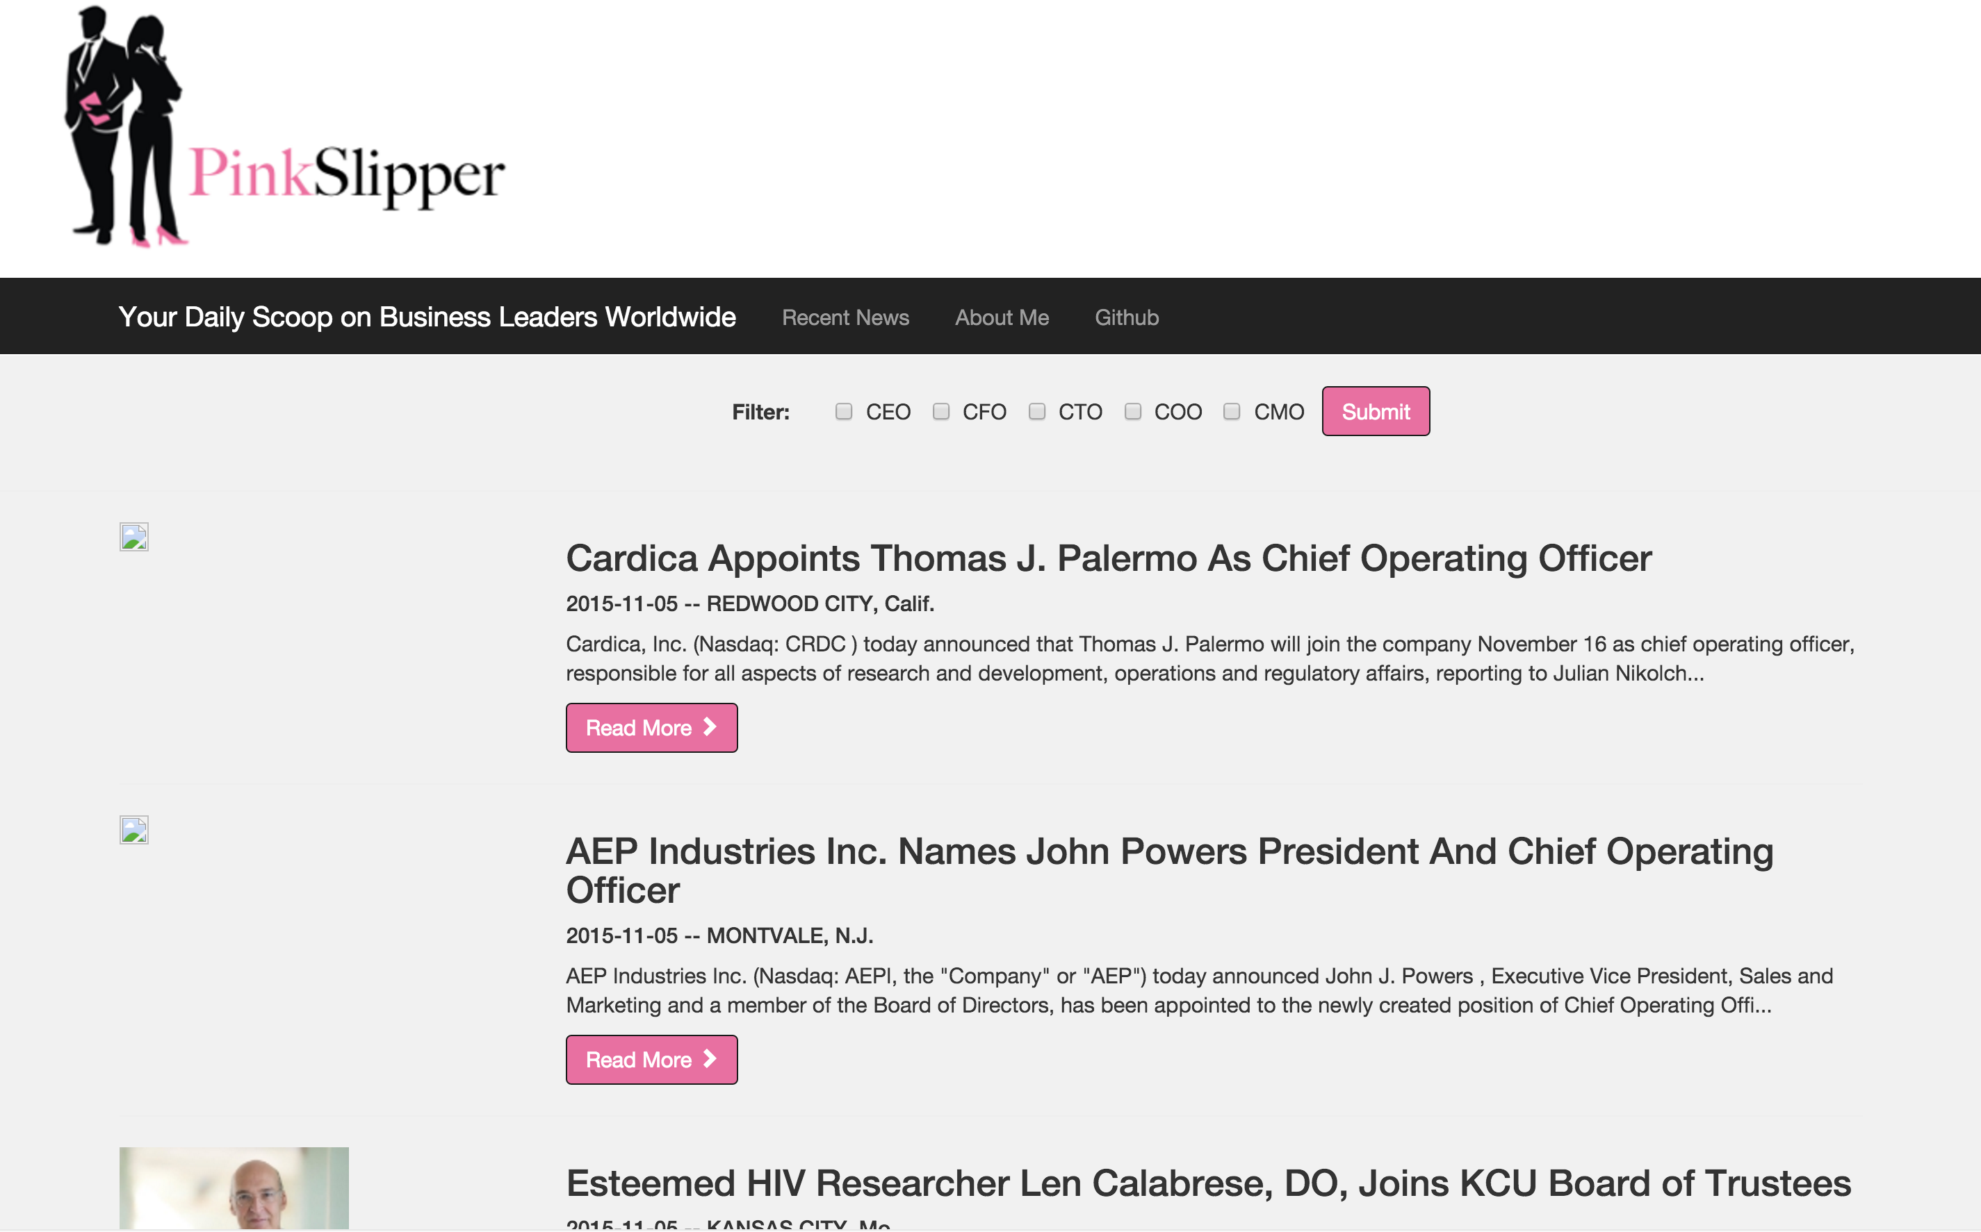
PinkSlipper

Slide 3
Pipeline
Collecting Data
Label Training Data
Building the model
Connecting pipeline
Front End Web App

Slide 4
Collecting Data
10,000 articles scraped
Feature
Engineering
Cleaning

Slide 5
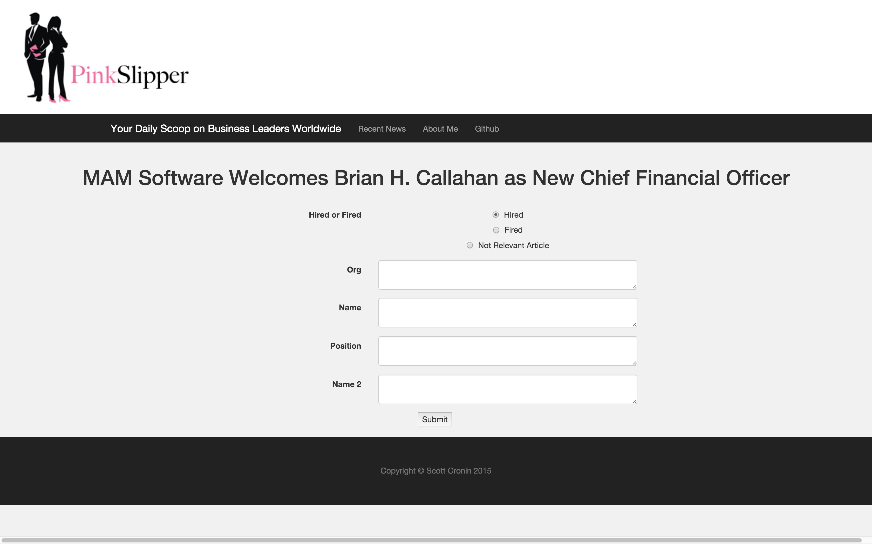
Label Training Data

Slide 6
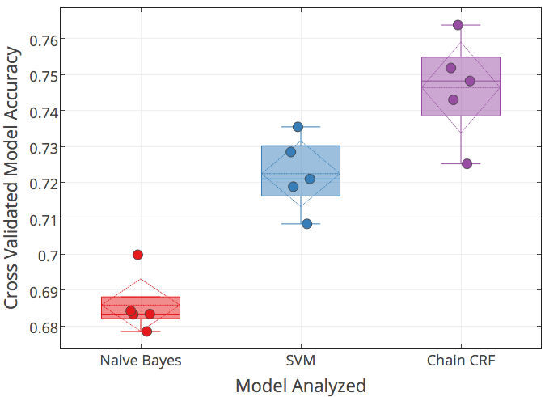
Model Development
Cross-Validated modeling approach using 550 labelled headlines
ChainCRF model was best

Slide 7
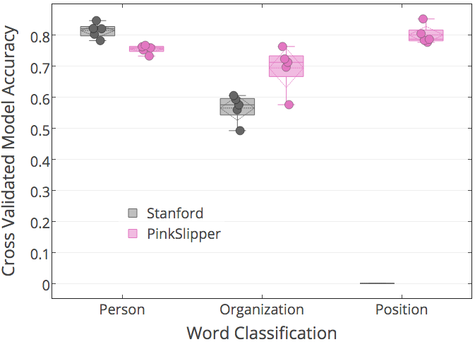
Stanford vs PinkSlipper Label Accuracy
Person:
Stanford better by 5%
Organization:
PinkSlipper better by 13%
Position:
PinkSlipper predicts 80%
Stanford not trained to predict
PinkSlipper Chain CRF works better for headlines

Slide 8
Model in Action
Fulcrum Equity Partners Promotes Philip Lewis to Principal
Stephen Bye named Chief Technology Officer for C Spire
MasterCard Promotes Ed McLaughlin to CIO
Former Amtrak Executive Named CIO at Veritiv
Donald Steinberg Appointed as
Chairman and CEO of Converge Global Inc.

Slide 9
Web App for Executive Recruiters

Slide 10
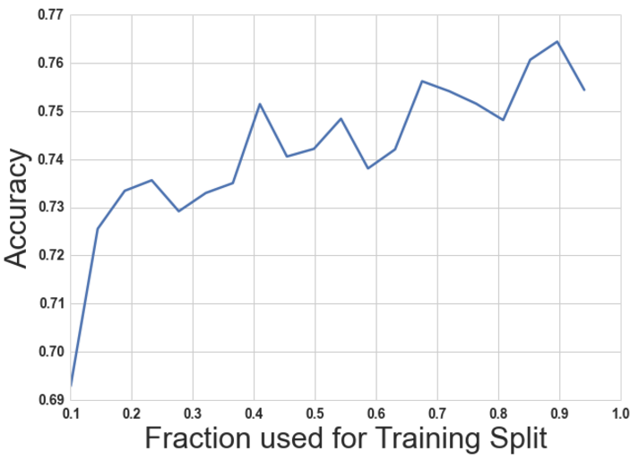
Accuracy vs Train Split Size
Training was done on 350 articles.
Increase training size from 30% to 70% (ie increasing from 100 articles to 250) improved model accuracy by 3%
Demonstrates some improvements in model, but there is limited return

Slide 11
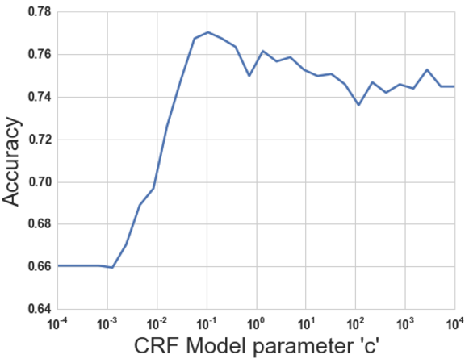
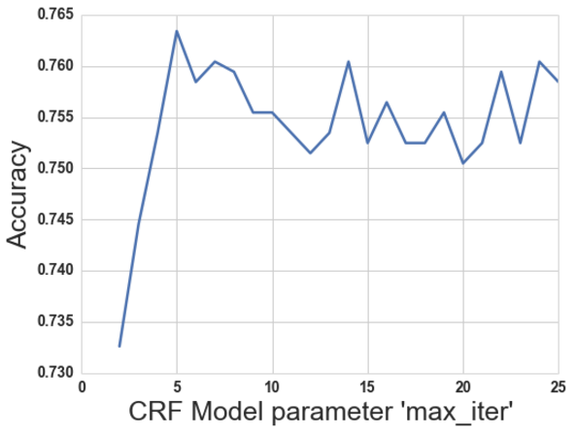
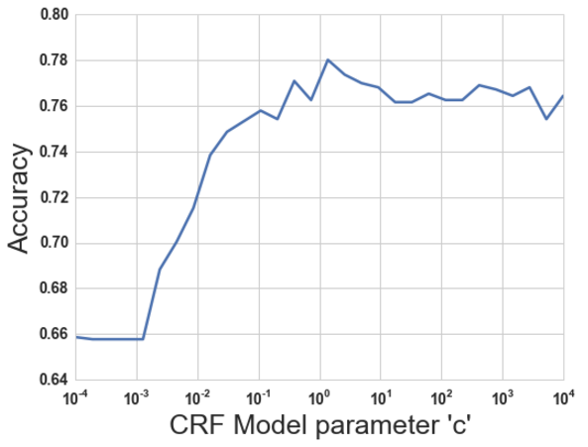
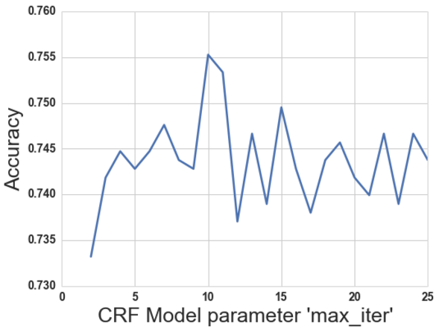
Model Tuning – Chain CRF
CRF Model parameter c = 0.5
CRF Model parameter max_iter = 11

Slide 12
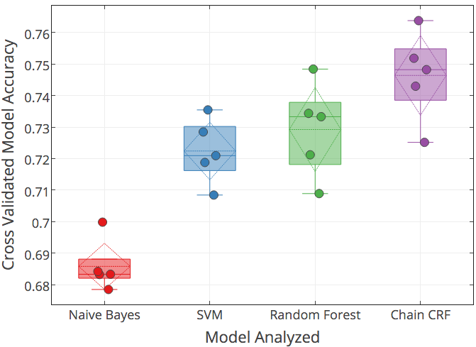
Model Development
Cross-Validated modeling approach using 550 labelled headlines
ChainCRF model was best

Slide 13
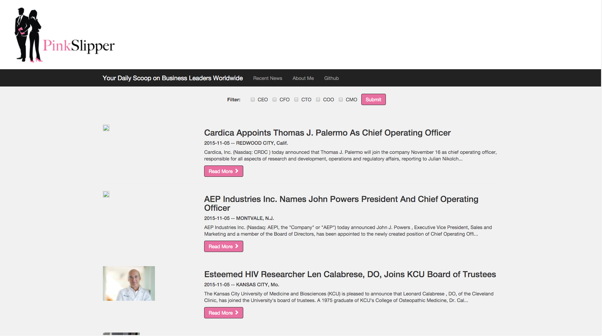
Demonstration

